Slide 1

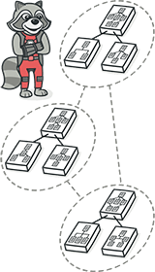
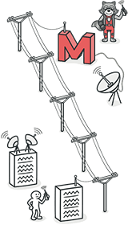
Software Design Patterns
Teamfight Tactics
Group 16
2250758 林继申 2251730 刘淑仪 2252843 杨宇琨 2256225 中谷天音

Slide 2

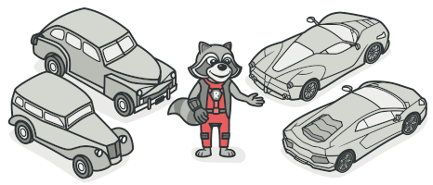
Software Design Patterns
Contents
Introduction and Motivation
Refactoring with Design Patterns
Critical Problems and Solutions

Slide 3




Introduction
This project is an Auto Chess game developed using the Cocos2d-x 3.17.2 engine, inspired by classic Auto Chess games like Dota Auto Chess, Teamfight Tactics, and Chess Rush. The game is strategy-based, where players collect, upgrade, and combine different hero cards to build powerful lineups and battle against AI or other players.
Software Design Patterns

Slide 4
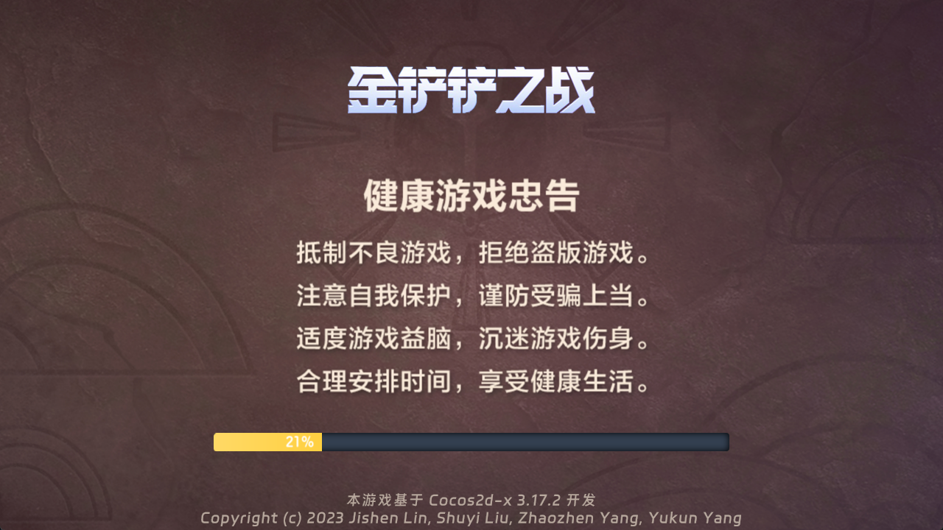





Introduction
Several snapshots of our project :
Software Design Patterns

Slide 5
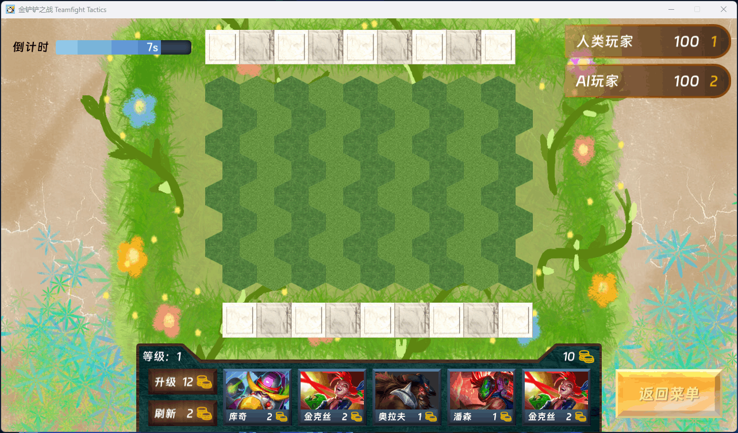
Introduction
A brief demonstration:
Software Design Patterns

Slide 6
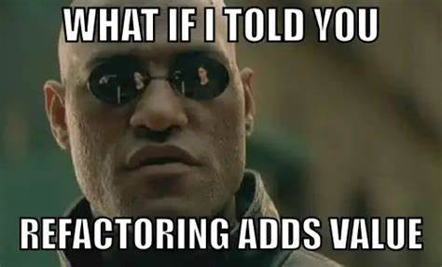
Motivation
When dealing with legacy code, refactoring helps transform it into clean, clear code with a well-structured design. The main goal of refactoring is to address technical debt. Although it may take some time, future extensions built on this foundation will be much less painful.
This is why we need refactoring!
Software Design Patterns

Slide 7
Refactoring with Design Patterns
Creational Patterns
Structural Patterns
Behavioral Patterns
Additional Pattern
Strategy Pattern
Builder Pattern
Composite Pattern
State Pattern
Reactor Pattern
Singleton Pattern
Facade Pattern
Observer Pattern
In our project, we applied 8 design patterns to refactor the code: 2 Creational Patterns, 2 Structural Patterns, 3 Behavioral Patterns, and 1 Additional pattern: Reactor Pattern, which was not covered in class These patterns helped us improve code maintainability, scalability, and performance, making the system more modular and adaptable.
Software Design Patterns

Slide 8
Builder Pattern
Original Problems
Maintainability Issues
Scattered Constant Definitions
Hardcoding
Scalability Issues
Difficult to Add New Attributes
Attribute Redundancy
High Initialization Complexity
Too Many Constructor Parameters
Default Value Issues
Lack of Flexibility
Fixed Attribute Settings
Software Design Patterns

Slide 9
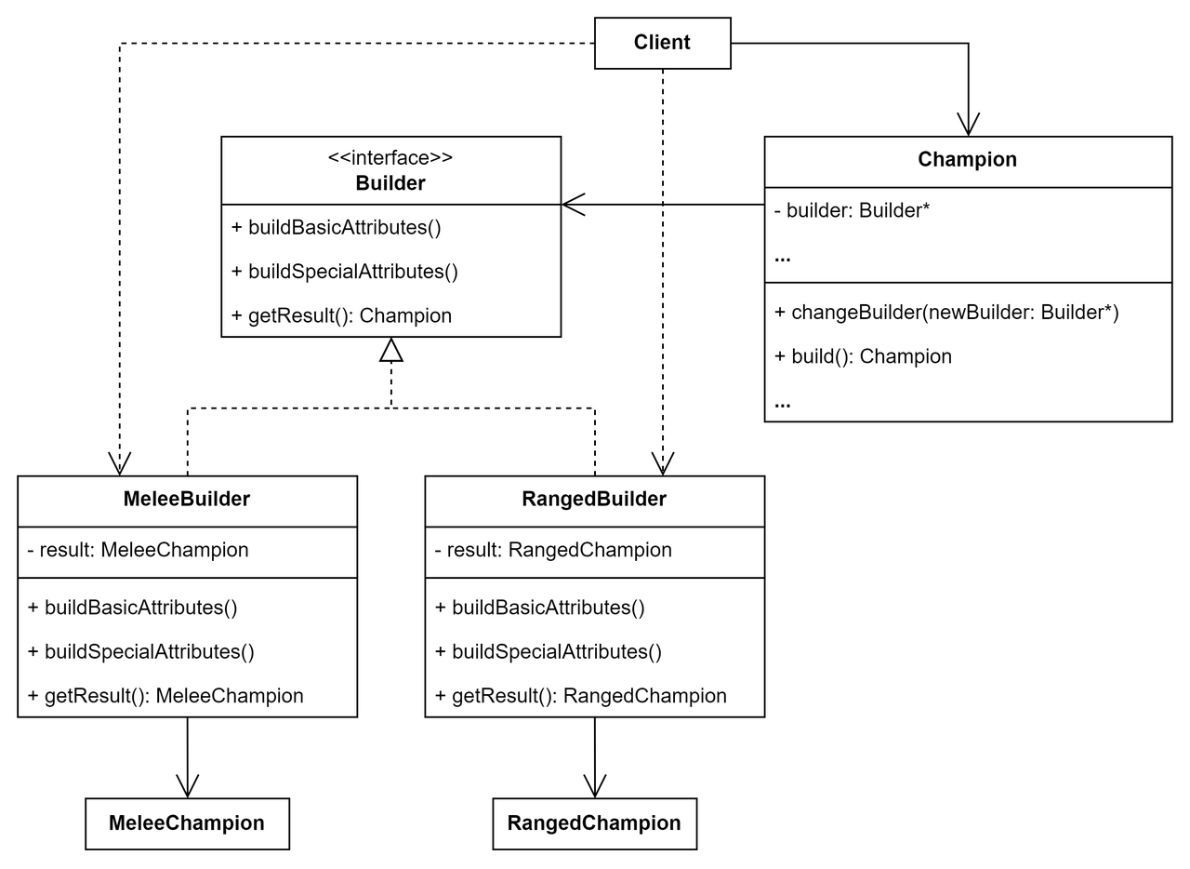
Builder Pattern
UML
Software Design Patterns

Slide 10
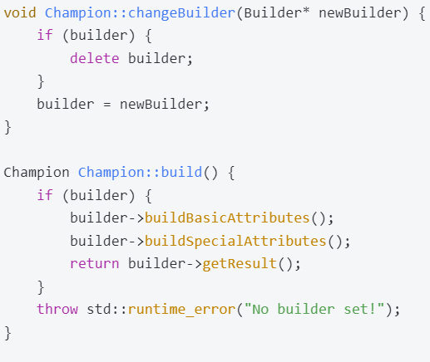
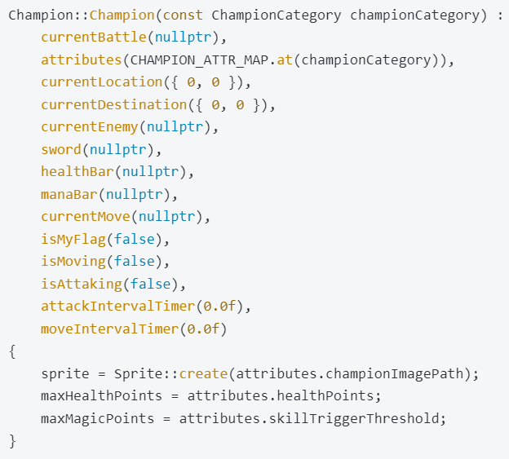
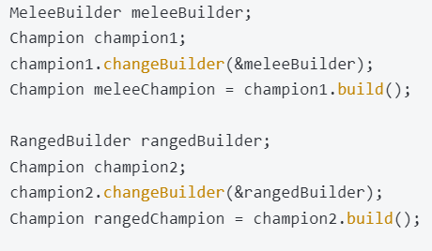
Builder Pattern
Code
Software Design Patterns

Slide 11
Builder Pattern
Implemented Improvements
Clear Distinction Between Melee and Ranged Heroes
Improved Maintainability
Enhanced Scalability
Simplified Initialization
Increased Flexibility
Reduce Attribute Redundancy
Software Design Patterns

Slide 12
Composite Pattern
Original Problems
Code Duplication
Lack of Flexibility
Tight Coupling
Software Design Patterns

Slide 13
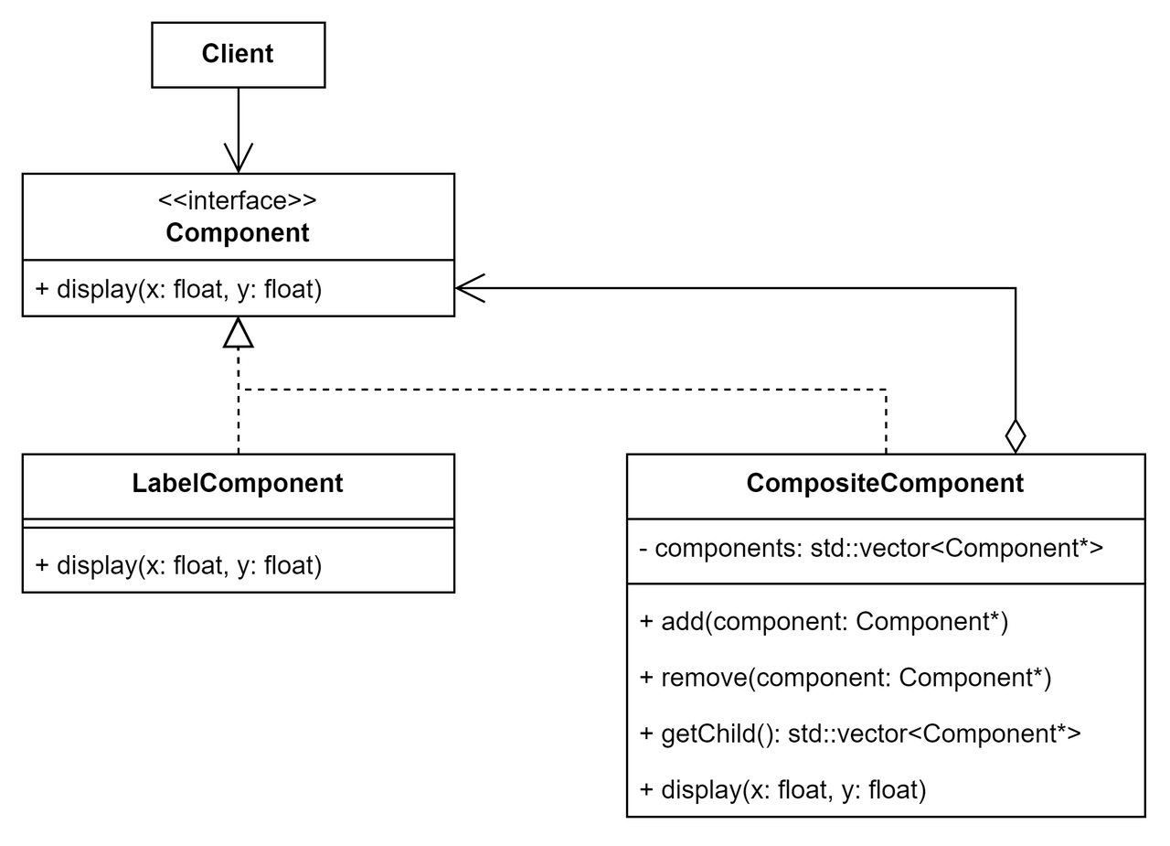
Composite Pattern
UML
Software Design Patterns

Slide 14
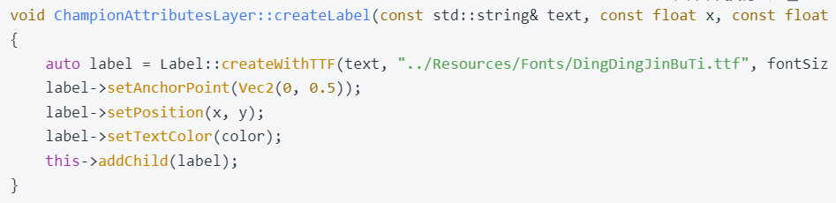
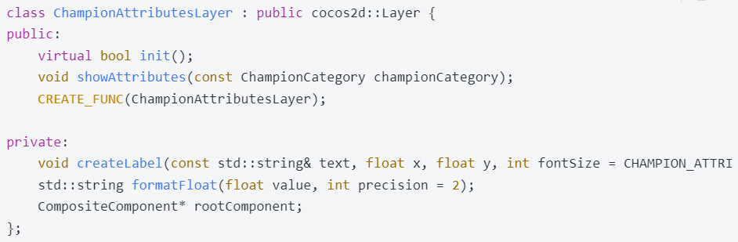
Composite Pattern
Code
Software Design Patterns

Slide 15
Composite Pattern
Implemented Improvements
Decoupling and Abstraction
Reduced Code Duplication
Support for Multiple Node Types
Unified Node Management
Improved Code Readability
Support for Dynamic Structures
Simplified Client Code
Software Design Patterns

Slide 16
Singleton Pattern
Original Problems
Multiple Instances Problem
Global Access Problem
Initialization Problem
Software Design Patterns

Slide 17
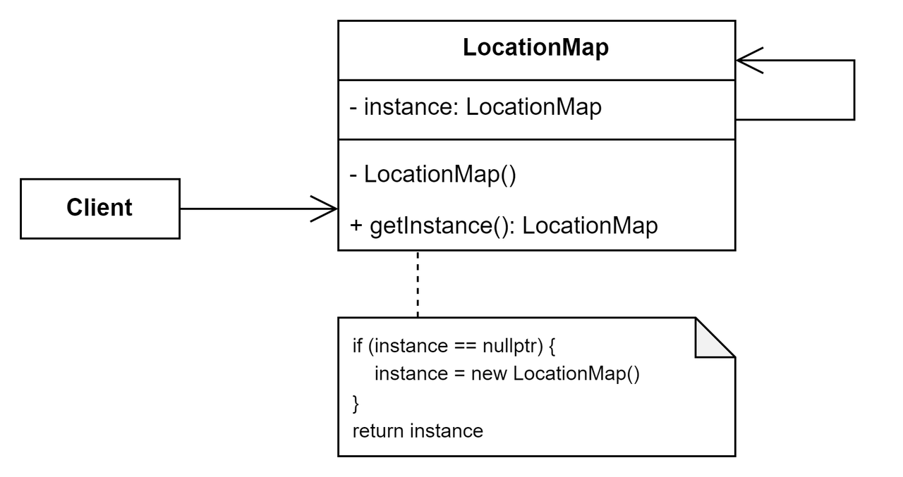
Singleton Pattern
UML
Software Design Patterns

Slide 18
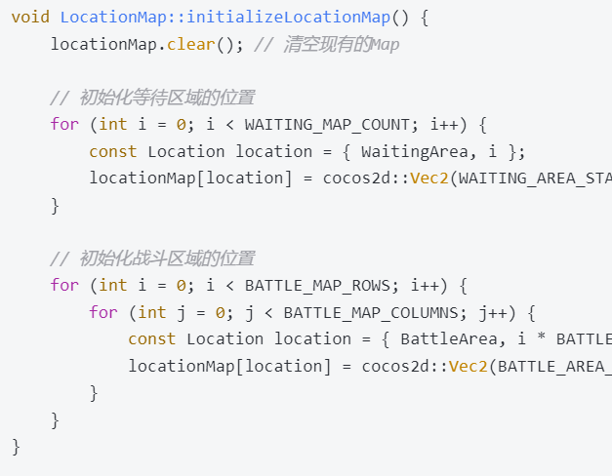
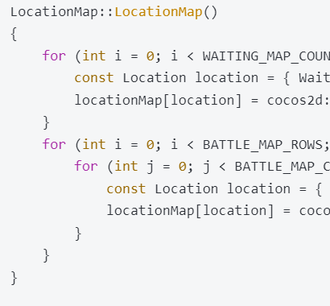
Singleton Pattern
Code
Software Design Patterns

Slide 19
Singleton Pattern
Implemented Improvements
Single Instance Management
Simplified Global Access
Initialization Optimization
Code Simplification
Prevention of Illegal Instantiation
Enhanced Testability
Software Design Patterns

Slide 20
Facade Pattern
Original Problems
High Coupling
Code Duplication
Difficult to Extend
Global Variable Risks
Lack of Encapsulation
Software Design Patterns

Slide 21
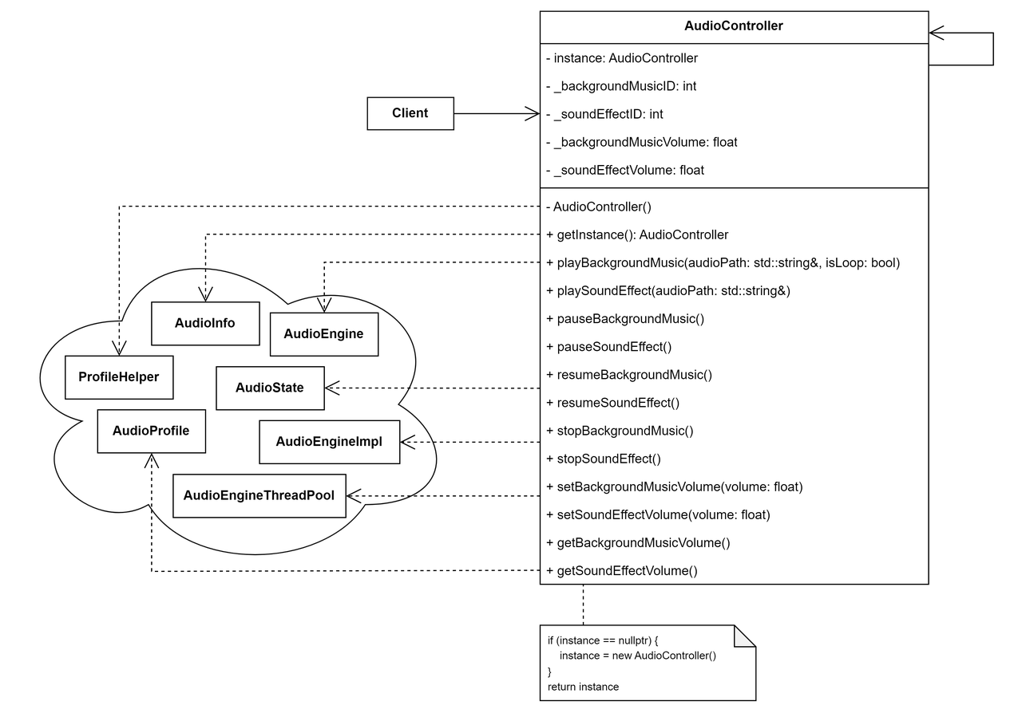
Facade Pattern
UML
Software Design Patterns

Slide 22
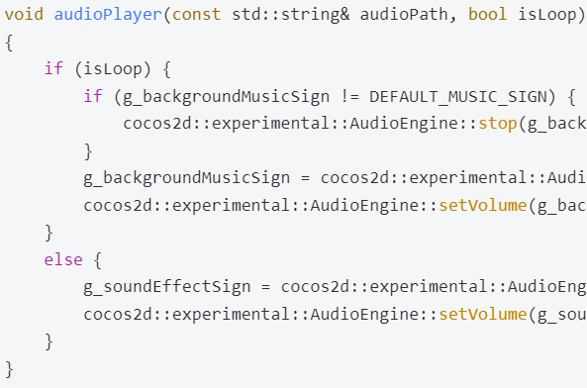
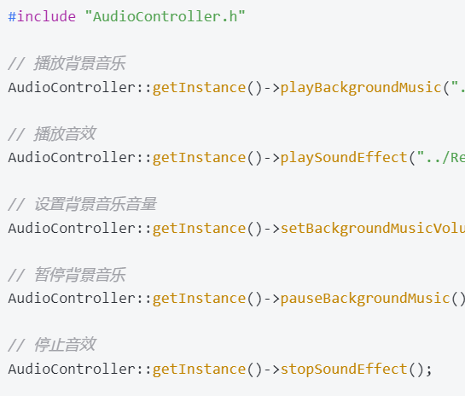
Facade Pattern
Code
Software Design Patterns

Slide 23
Facade Pattern
Implemented Improvements
Reduced Coupling
Reduced Code Duplication
Enhanced Extensibility
Eliminated Global Variable Risks
Unified Interface Provided
Supports Singleton Pattern
Simplified Client Code
Improved Code Readability
Software Design Patterns

Slide 24
Strategy Pattern
Original Problems
Too Many Conditional Branches
Violates the Open-Closed Principle
Violates the Single Responsibility Principle
Poor Extensibility
Software Design Patterns

Slide 25
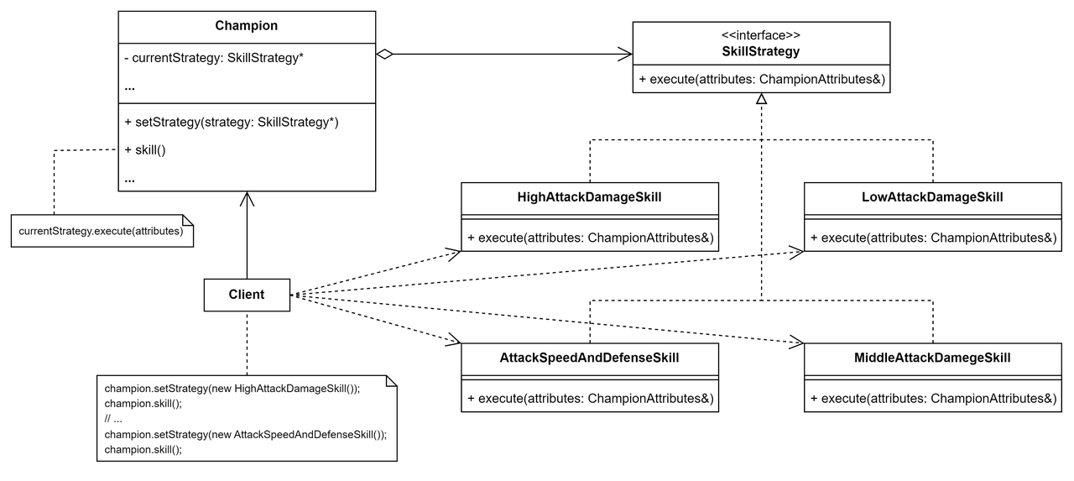
Strategy Pattern
UML
Software Design Patterns

Slide 26
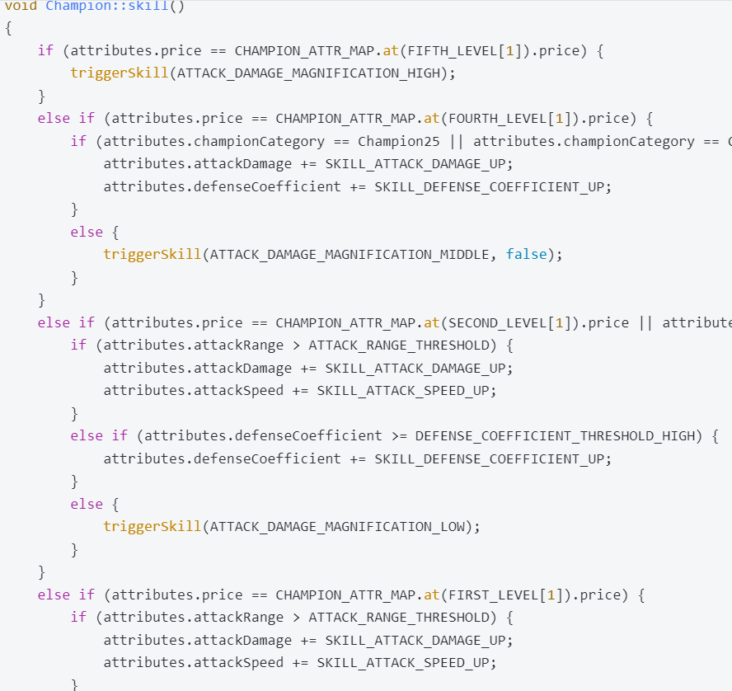
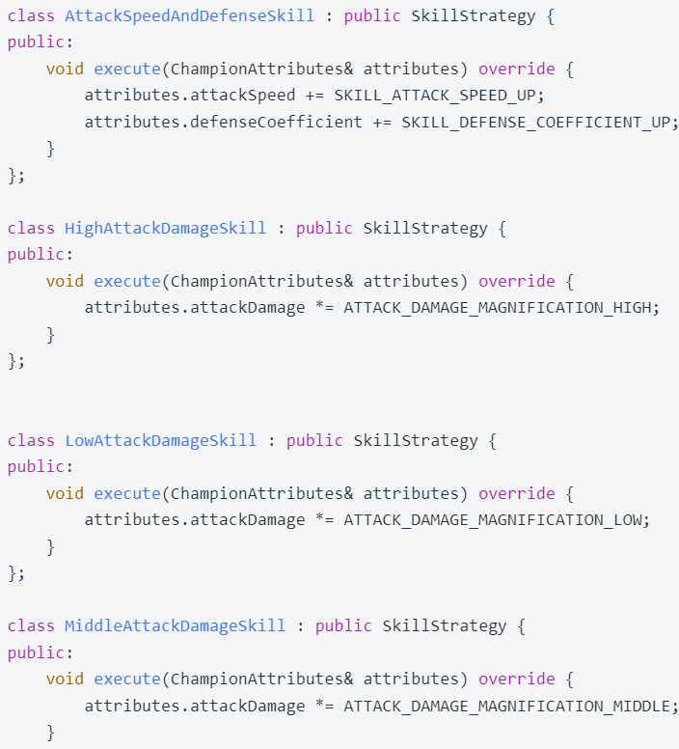
Strategy Pattern
Code
Software Design Patterns

Slide 27
Strategy Pattern
Implemented Improvements
Elimination of Conditional Branches
Adherence to the Open/Closed Principle
Single Responsibility Principle
Improved Extensibility
Code Reusability
Enhanced Readability
Dynamic Strategy Switching
Software Design Patterns

Slide 28
State Pattern
Original Problems
Excessive Conditional Branches
Violation of the Open/Closed Principle
Violation of the Single Responsibility Principle
Poor Extensibility
Software Design Patterns

Slide 29
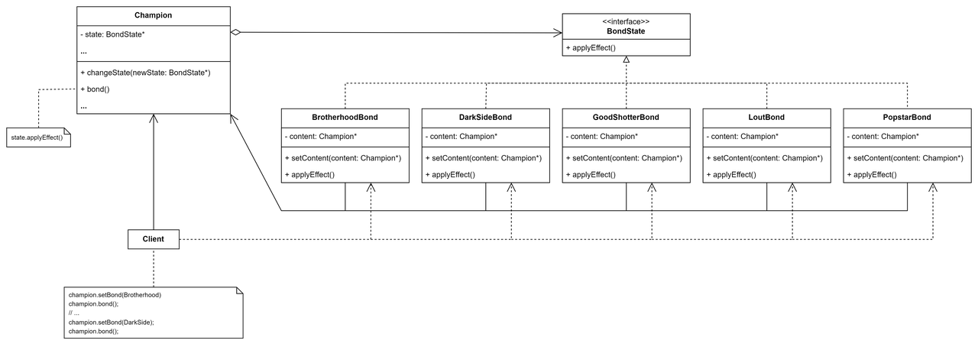
State Pattern
UML
Software Design Patterns

Slide 30
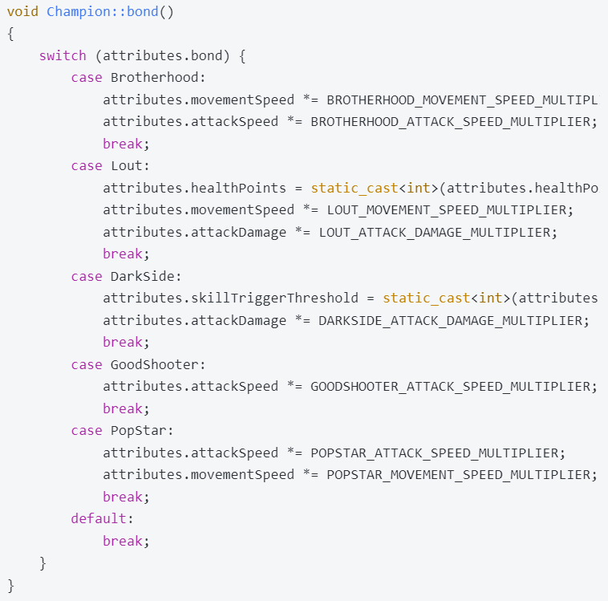
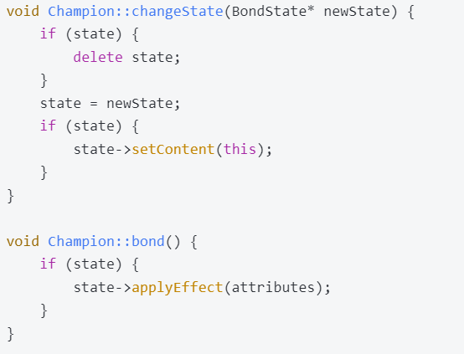
State Pattern
Code
Software Design Patterns

Slide 31
State Pattern
Implemented Improvements
Elimination of Conditional Branches
Adherence to the Open/Closed Principle
Single Responsibility Principle
Improved Extensibility
Code Reusability
Enhanced Readability
Dynamic State Switching
Software Design Patterns

Slide 32
Observer Pattern
Original Problems
Tight Coupling
Single Responsibility Principle
Poor Extensibility
Software Design Patterns

Slide 33
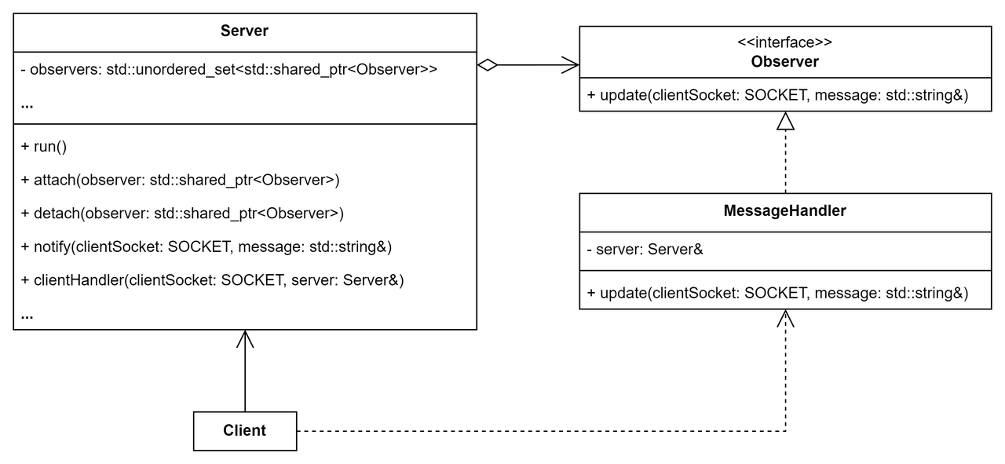
Observer Pattern
UML
Software Design Patterns

Slide 34
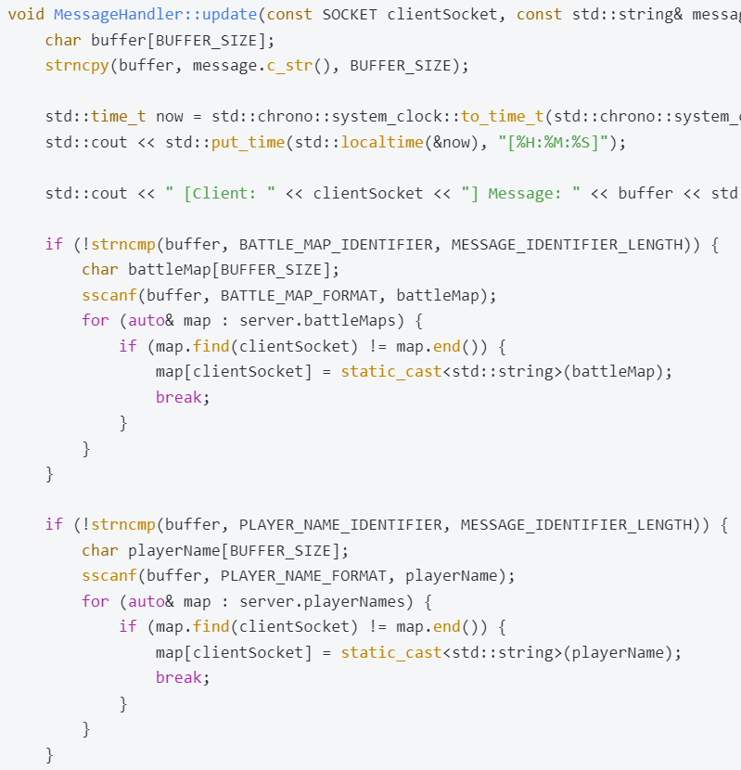
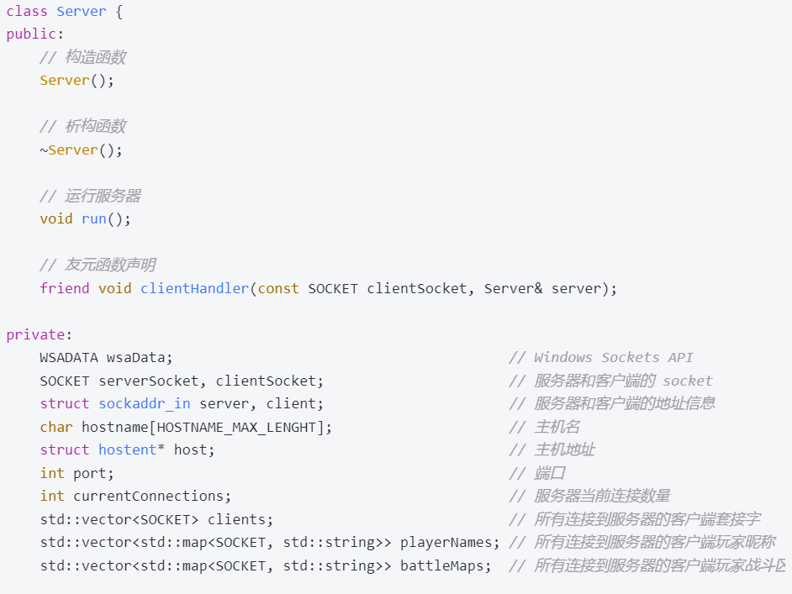
Observer Pattern
Code
Software Design Patterns

Slide 35
Observer Pattern
Implemented Improvements
Decoupling and Abstraction
Single Responsibility Principle
Enhanced Extensibility
Dynamic Observer Addition
Code Reusability
Improved Readability
Support for Multiple Message Types
Software Design Patterns

Slide 36
Reactor Pattern
Original Problems
Blocking I/O
Complex Thread Management
Lack of Event-Driven Mechanism
Software Design Patterns

Slide 37
Reactor Pattern
The Reactor Pattern is an event-driven design pattern used for efficiently handling multiple service requests concurrently. The key component of this pattern is an event loop, typically running in a single thread or process, which handles multiplexing incoming requests and dispatches them to the appropriate request handler.
Core Concepts:
Event-driven: The Reactor Pattern handles I/O operations through event notifications instead of blocking I/O or multithreading. This allows efficient handling of numerous concurrent I/O requests in a single thread.
Non-blocking I/O: The Reactor Pattern relies on non-blocking I/O, where events are triggered only when I/O operations are completed, avoiding the issue of blocking threads waiting for I/O.
Callback Mechanism: Request handlers are registered as callback functions within the event loop. When an event occurs, the event loop calls the corresponding handler function to process the event. This design separates event handling logic from event dispatching, enhancing flexibility and maintainability.
Software Design Patterns

Slide 38
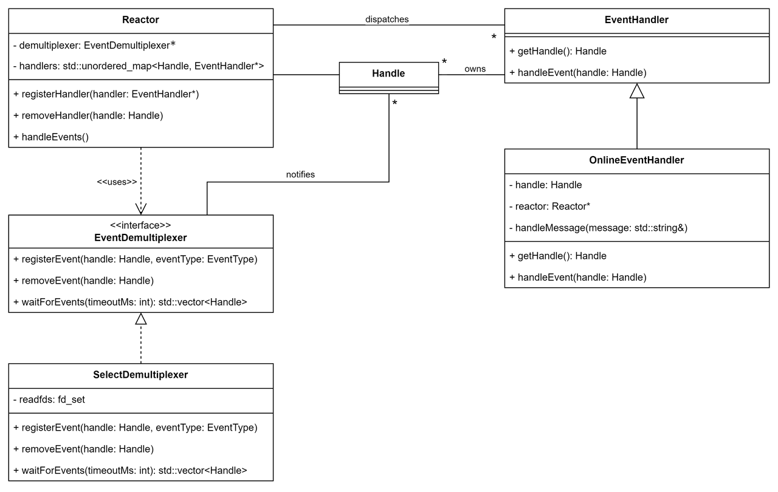
Reactor Pattern
UML
Software Design Patterns

Slide 39
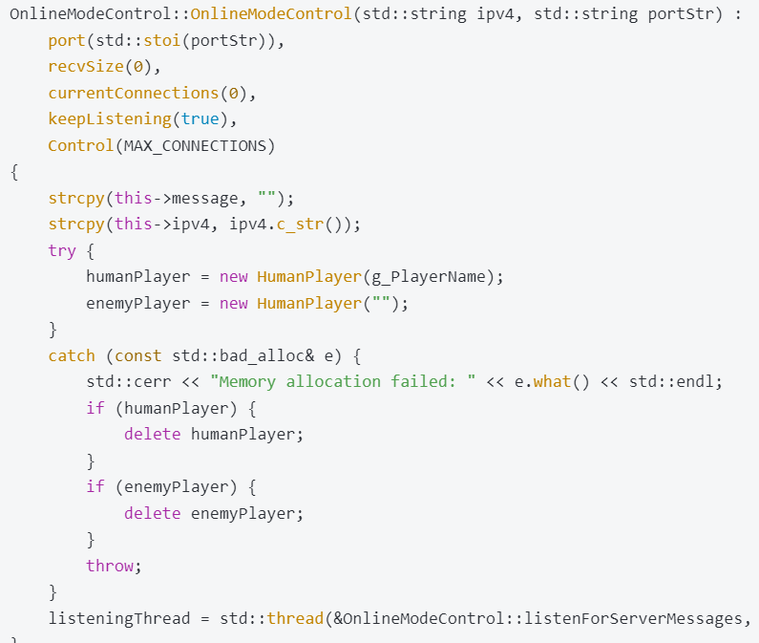
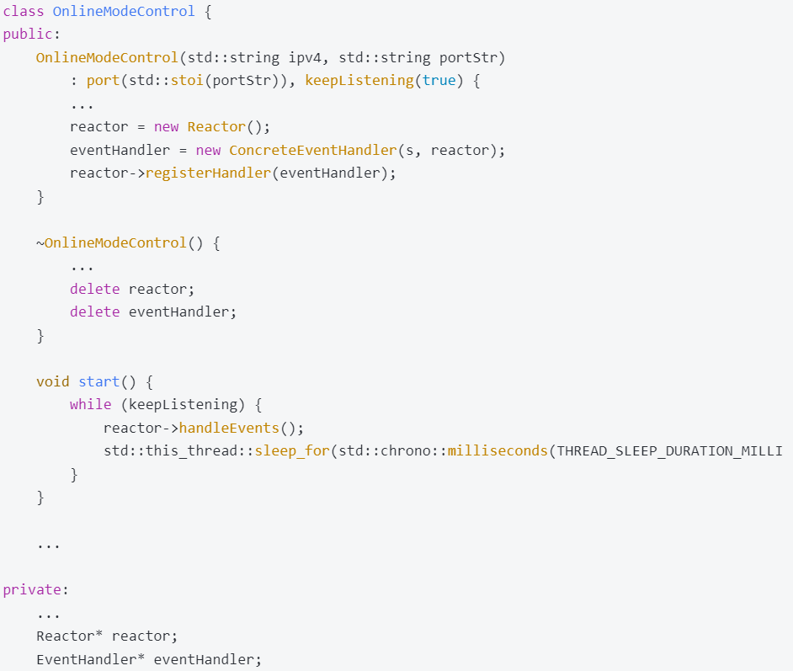
Reactor Pattern
Code
Software Design Patterns

Slide 40
Reactor Pattern
Implemented Improvements
Non-blocking I/O
Event-driven Mechanism
Simplified Thread Management
High Concurrency Handling
Flexibility
Low Resource Consumption
Improved Readability
Software Design Patterns

Slide 41
Critical Problems and Solutions
1. Tight Coupling
Issue: Server class tightly coupled with client connection and message handling.
Solution: Applied Observer pattern to decouple responsibilities and improve maintainability.
2. Single Responsibility Violation
Issue: Server class managed multiple tasks, violating the single responsibility principle.
Solution: Separated responsibilities into distinct classes for better clarity and scalability.
3. Poor Scalability
Issue: Difficult to extend the system due to hardcoded logic.
Solution: Used Strategy and Observer patterns to allow easy extensions without affecting existing functionality.
Software Design Patterns

Slide 42
Software Design Patterns
THANKS !
Group 16
2250758 林继申 2251730 刘淑仪 2242843 杨宇琨 2256225 中谷天音

